Slide 2

Doraemon team
Web Animation – Tips and Tricks

Slide 4
Main Points
Simple hover effect
Zoom lens with animation
Parallax effect

Slide 5
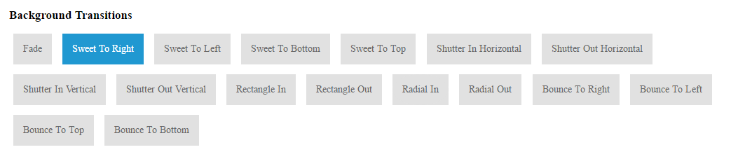
Hover effect

Slide 6
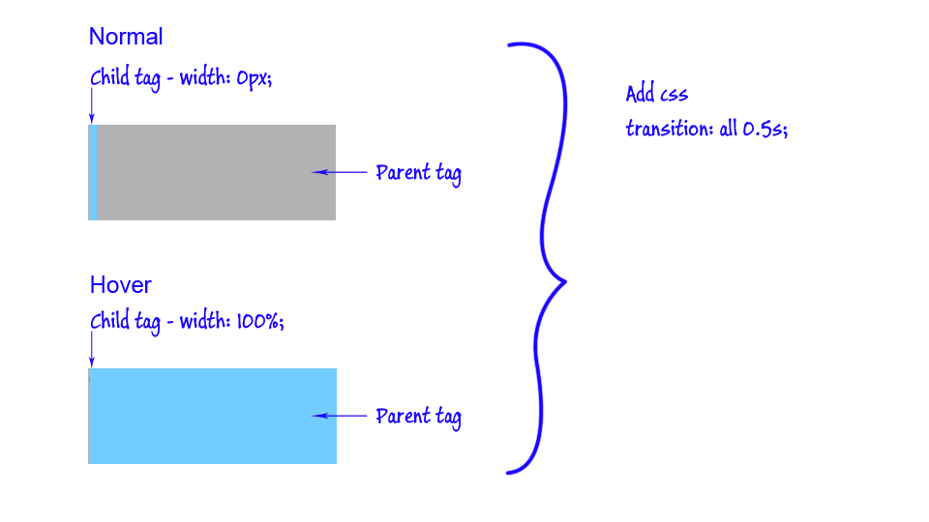
Hover effect

Slide 8
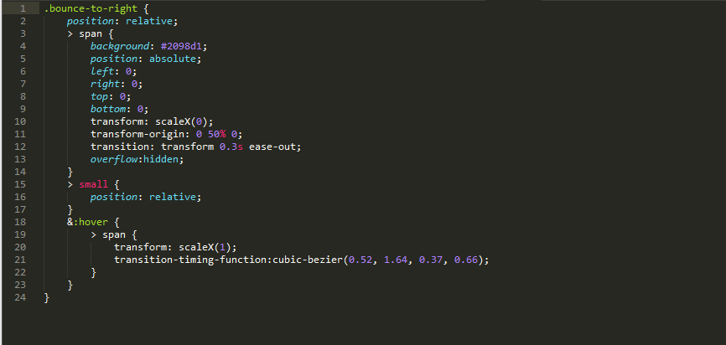
Hover effect

Slide 9
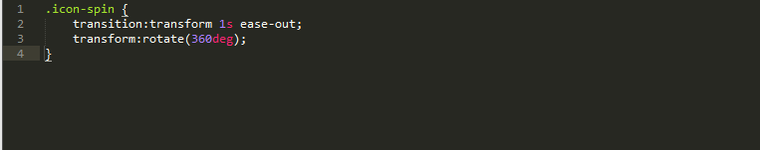
Hover effect

Slide 10
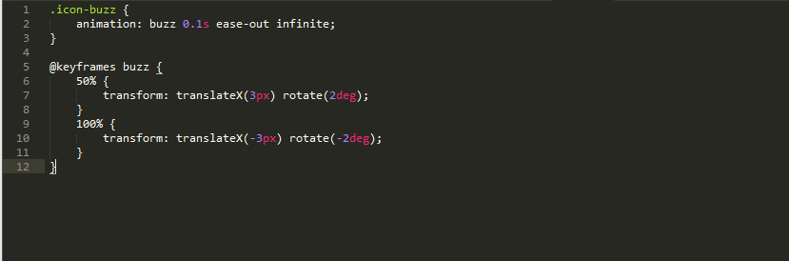
Hover effect

Slide 12

Zoom lens with animation

Slide 13
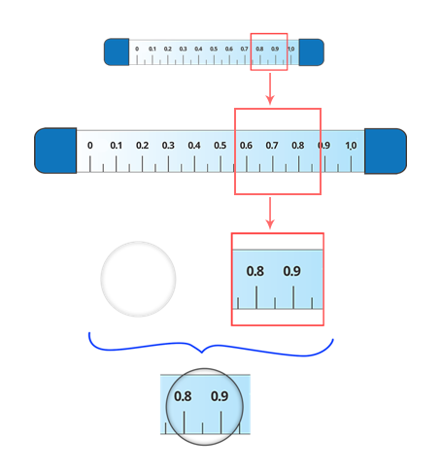
Zoom lens with animation

Slide 14

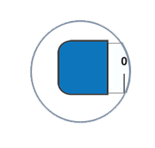

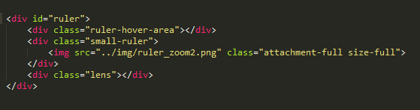
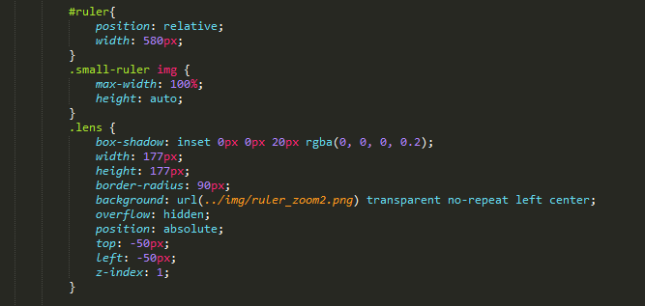
Zoom lens with animation

Slide 15
Zoom lens with animation

Slide 16
Zoom lens with animation

Slide 17
Zoom lens with animation

Slide 18
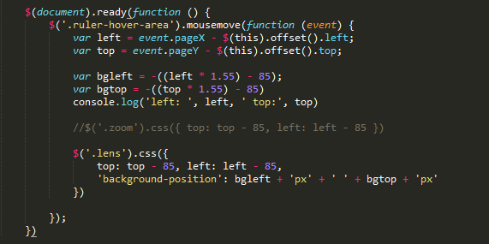
Zoom lens with animation

Slide 19
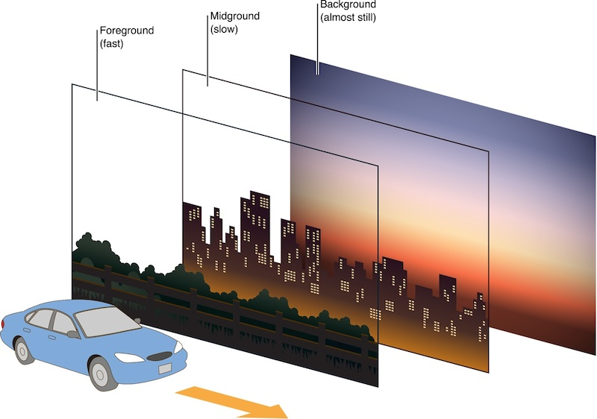
Parallax effect

Slide 20
Simple example

Slide 21
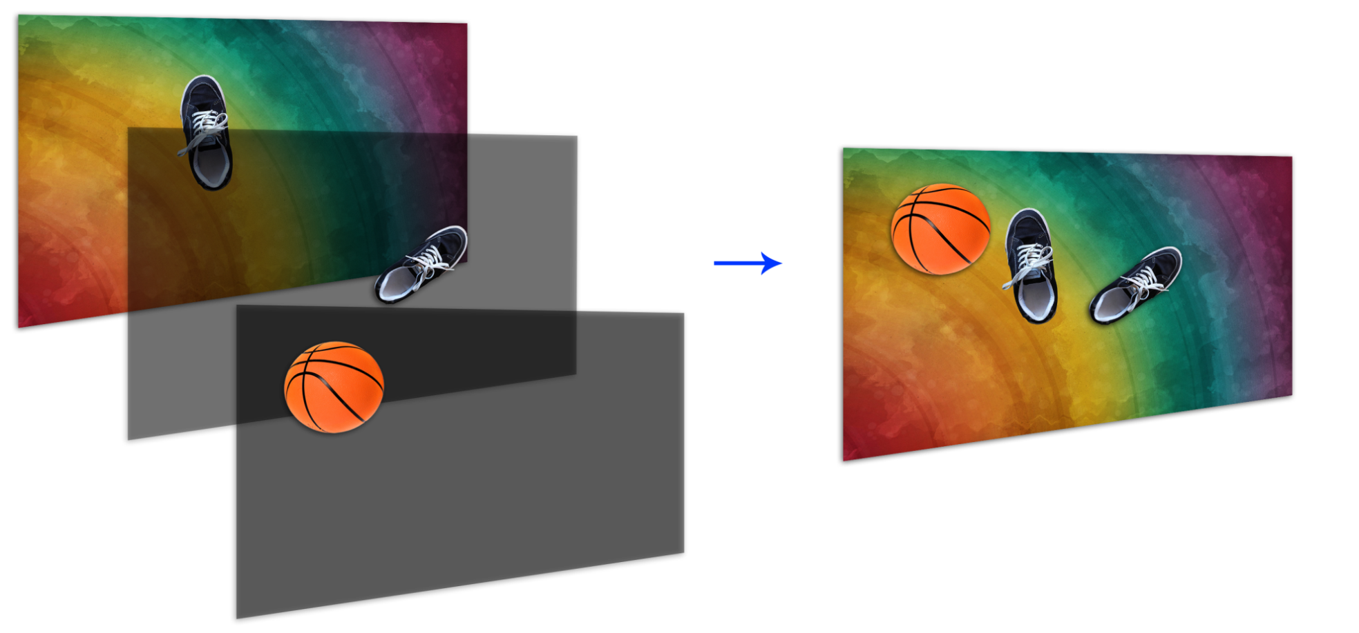
Parallax effect

Slide 22
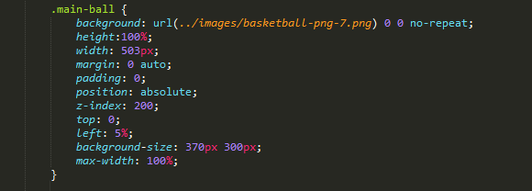

Slide 23
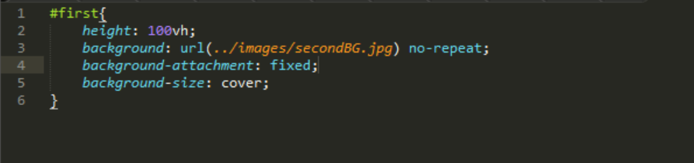
Parallax effect

Slide 24
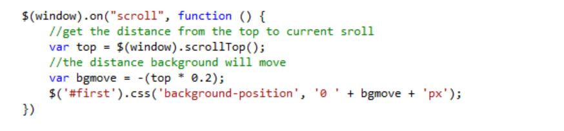
Parallax effect

